Slide 1
Supervised ML-Classification Credit Card Fraud Detection Prediction
By
ALOK KUMAR
Data science trainee, Alma Better, Bangalore

Slide 2
Points for Discussion
Problem Statement
Introduction
Basic Visualization
Classification models on Credit Card Data

Slide 3
Problem Statement
This project is aimed at predicting the case of customers default payments in Taiwan. From the perspective of risk management, the result of predictive accuracy of the estimated probability of default will be more valuable than the binary result of classification - credible or not credible clients.
We can use the K-S chart to evaluate which customers will default on their credit card payments.

Slide 4
Introduction
In recent years, the credit card issuers in Taiwan faced the cash and credit card debt crisis and the delinquency is expected to peak in the third quarter of 2006 (Chou,2006).
In order to increase market share, card-issuing banks in Taiwan over-issued cash and credit cards to unqualified applicants.
At the same time, most cardholders, irrespective of their repayment ability, overused credit card for consumption and accumulated heavy credit and cash–card debts.
The crisis caused the blow to consumer finance confidence and it is a big challenge for both banks and cardholders

Slide 5
Dataset Summary
Attribute Information:
This research employed a binary variable, default payment (Yes = 1, No = 0), as the response variable. This study reviewed the literature and used the following 23 variables as explanatory variables:
X1: Amount of the given credit (NT dollar): it includes both the individual consumer credit and his/her family (supplementary) credit.
X2: Gender (1 = male; 2 = female).
X3: Education (1 = graduate school; 2 = university; 3 = high school; 4 = others).
X4: Marital status (1 = married; 2 = single; 3 = others).
X5: Age (year).
X6 - X11: History of past payment. We tracked the past monthly payment records (from April to September, 2005) as follows:
X6 = the repayment status in September, 2005;
X7 = the repayment status in August, 2005; . . .;
X11 = the repayment status in April, 2005. The measurement scale for the repayment status is: -1 = pay duly; 1 = payment delay for one month; 2 = payment delay for two months; . . .; 8 = payment delay for eight months; 9 = payment delay for nine months and above.
X12-X17: Amount of bill statement (NT dollar).
X12 = amount of bill statement in September, 2005;
X13 = amount of bill statement in August, 2005; . . .;
X17 = amount of bill statement in April, 2005.
X18-X23: Amount of previous payment (NT dollar).
X18 = amount paid in September, 2005;
X19 = amount paid in August, 2005; . . .;
X23 = amount paid in April, 2005.

Slide 6
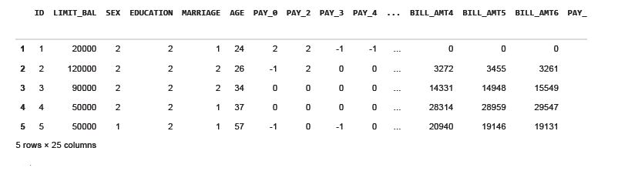
Sample of data

Slide 7
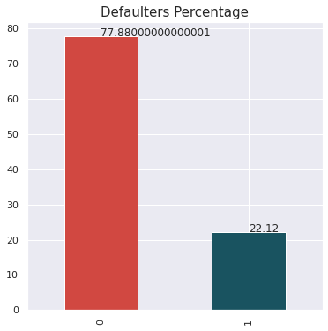
Showing percentage of defaulters present in our dataset.
We have 22% defaulters in our dataset and 77% persons are non defaulters.

Slide 8
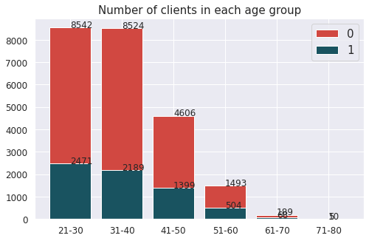
Checked the defaulters by age, sex, limit balance.
We have maximum clients from 21-30 age group followed by 31-40. Hence with increasing age group the number of clients that will default the payment next month is decreasing.

Slide 9
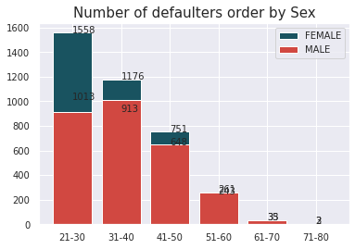
Calculated number of defaulters with respect to Gender and their respective AGES
Number of defaulters order by Sex we have female defaulters more than males in 20-30 age group.

Slide 10
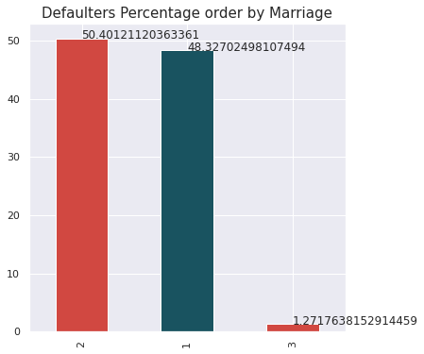
Plotting defaulters by their Marriage.
We can see there is no trend or behavior of married or unmarried people as a defaulter.

Slide 11
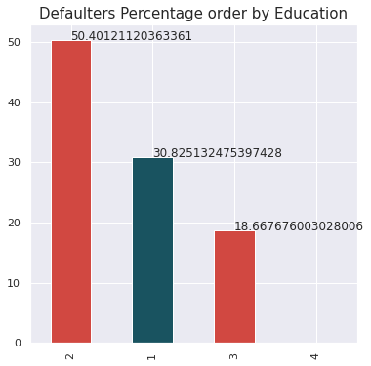
Plotting defaulters by their Education
University level student tend to default more followed by graduate and high school students.

Slide 12
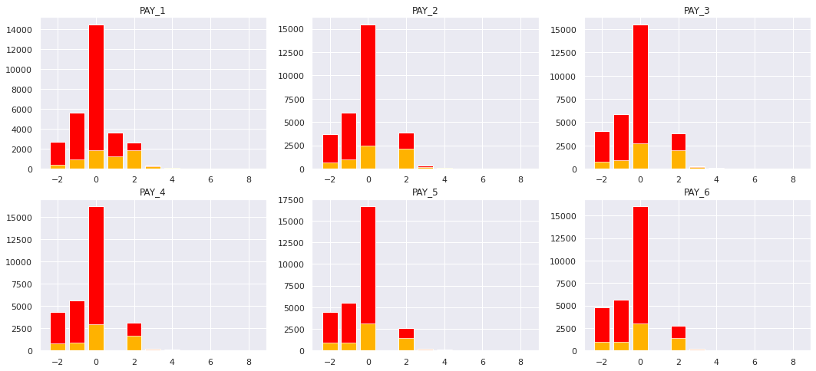
Plotting bar plot for each month payment status which show the count of defaulters and non-defaulter. .

Slide 13
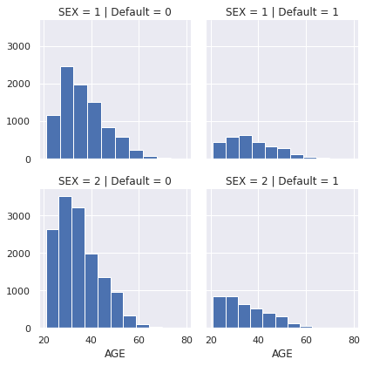
From the below FaceGrid Plot we can see that NonDefaults have a higher proportion of people 30-40 years.

Slide 14
Logistic Regression
In Logistic Regression, we wish to model a dependent variable(Y) in terms of one or more independent variables(X). It is a method for classification.
This algorithm is used for the dependent variable that is Categorical. Y is modeled using a function that gives output between 0 and 1 for all values of X. In Logistic Regression, the Sigmoid (aka Logistic).
Here we found the accuracy to be 0.7768.

Slide 15
Stochastic Gradient Descent
Stochastic Gradient Descent (SGD) is a simple yet very efficient approach to discriminative learning of linear classifiers under convex loss functions such as (linear) Support Vector Machines and Logistic Regression.
It is one of the Gradient Descent Algorithm. It uses only a single example (a batch size of 1) per iteration. Given enough iterations, SGD works but is very noisy.
The term "stochastic" indicates that the one example comprising each batch is chosen at random.
Model Accuracy Precision Recall F1 Score ROC
Stochastic
Gradient
Descent 0.573552 0.282042 0.589705 0.381582 0.579309

Slide 16
Random Forest
Testing Accuracy is- 0.8170917074818442
roc_auc_score is- 0.6521385314155942
recall_score is - 0.3542770628311885
KNN
Accuracy score is- 0.7714913021449079
roc_auc_score - 0.5286285916466444
recall_score is - 0.09008327024981075

Slide 17
SMOTE
Random Forest with SMOTE
Accuracy score is- 0.8091216216216216
roc_auc_score is- 0.6523221343873519
recall_score is - 0.3693181818181818
KNN with SMOTE
Accuracy score is- 0.7658361486486487
roc_auc_score - 0.5380393610013176
recall_score is - 0.1268939393939394

Slide 18
Random Under Sampler:
Random undersampling involves randomly selecting examples from the majority class and deleting them from the training dataset. In the random under-sampling, the majority class instances are discarded at random until a more balanced distribution is reached.
precision recall f1-score support
0 0.84 0.62 0.72 4600
1 0.31 0.60 0.41 1321
accuracy 0.62 5921
macro avg 0.58 0.61 0.57 5921
weighted avg 0.73 0.62 0.65 5921

Slide 19
Conclusion
Our best prediction accuracy was around 88-89%, our lowest measured prediction accuracy was about 13%. This is not a particularly large spread, especially considering the disparity in the time it takes for some models to train with the Grid Search to find the best hyper-parameters.
we streamlined the training and prediction process very well, but despite the feature engineering, and hyper parameter tuning we didn't see a particularly significant change in predictive power of our models.

Slide 20
If we were to make recommendation to a crediting agency about the granting of credit, with respect to the debtors likelihood to default, it would be:
Consider the applicant's marital status. Married people seem to default more often.
Consider the age of the applicant. Younger people are at higher risk of defaulting.
Establish a lower limit balance for applicants that would be considered risky.
Once granted credit, pay special attention to the ratio of payments to the amount owed on their balance. There will be some threshold were it's very unlikely that they will be able to pay you back.
Limit the number of months a debtor may be late on their payments to 3, like most credit agencies. At this point it's more likely that the person will default than pay you back. At this point you're only giving more money away.

Slide 21
THANK YOU

